Slide 1
Deer, Ticks and Tick-borne Illnesses on MV
Richard Johnson, Program Director
Tick-borne Illness Prevention Program
Sponsored by Dukes County and the Boards of Health of the Six Island Towns

Slide 2
Tick Life Cycle
https://www.cdc.gov/ticks

Slide 3
How Ticks Spread Disease
When a tick nymph or larvae feeds on a host’s blood, it can pick up a blood-borne infection.
During the next stage of its life cycle, when it feeds again, it can pass that infection on to its new host.
http://tickapp.tamu.edu/tickbiology.html

Slide 4
Our three species of ticks
Deer tick
(blacklegged tick)
Lone star tick
Dog tick

Slide 5
Lone star ticks: Our “New” island resident
Very fast moving and
aggressive.
The adult female has a
white dot or “lone star”
on her back.
Nymphs are “round and red” and also fast moving.
The nymph and adult females most frequently bite humans and transmit disease. (Larvae also bite humans, but are not believed to transmit diseases.)
Bite can result in an allergy to red meat
Information and image from: www.cdc.org/ticks

Slide 6
Not all ticks spread the same diseases!
Dog tick
Tularemia and Rocky Mountain spotted fever (Rickettsia ricketstii)
Deer tick
Lyme disease, anaplasmosis, babesiosis, and Powassan/deer tick fever, Miyamotoi disease
Lone star tick
Human ehrlichiosis, tularemia, STARI, and spotted fever (Rickettsia amblyommii)
Red meat allergy

Slide 7
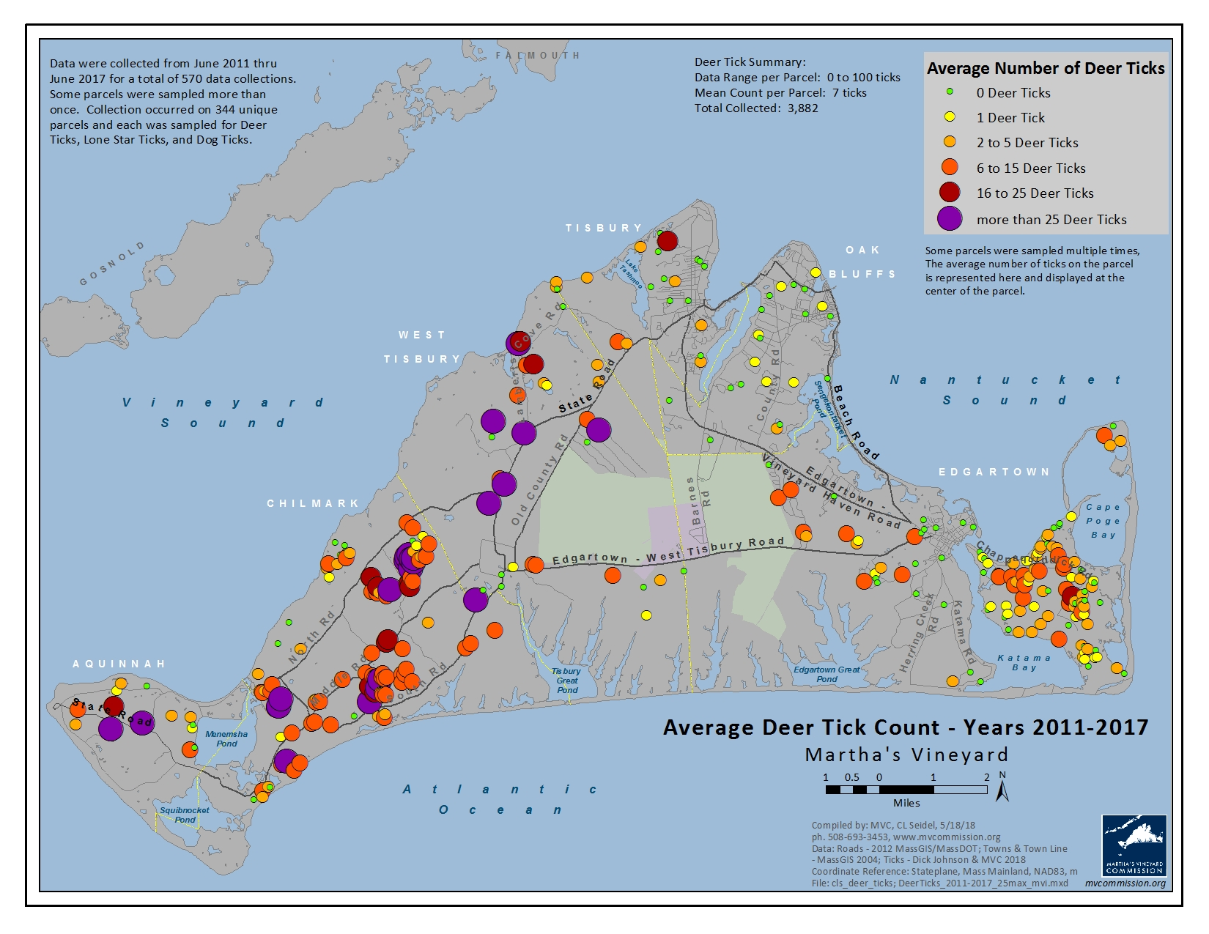

Slide 8
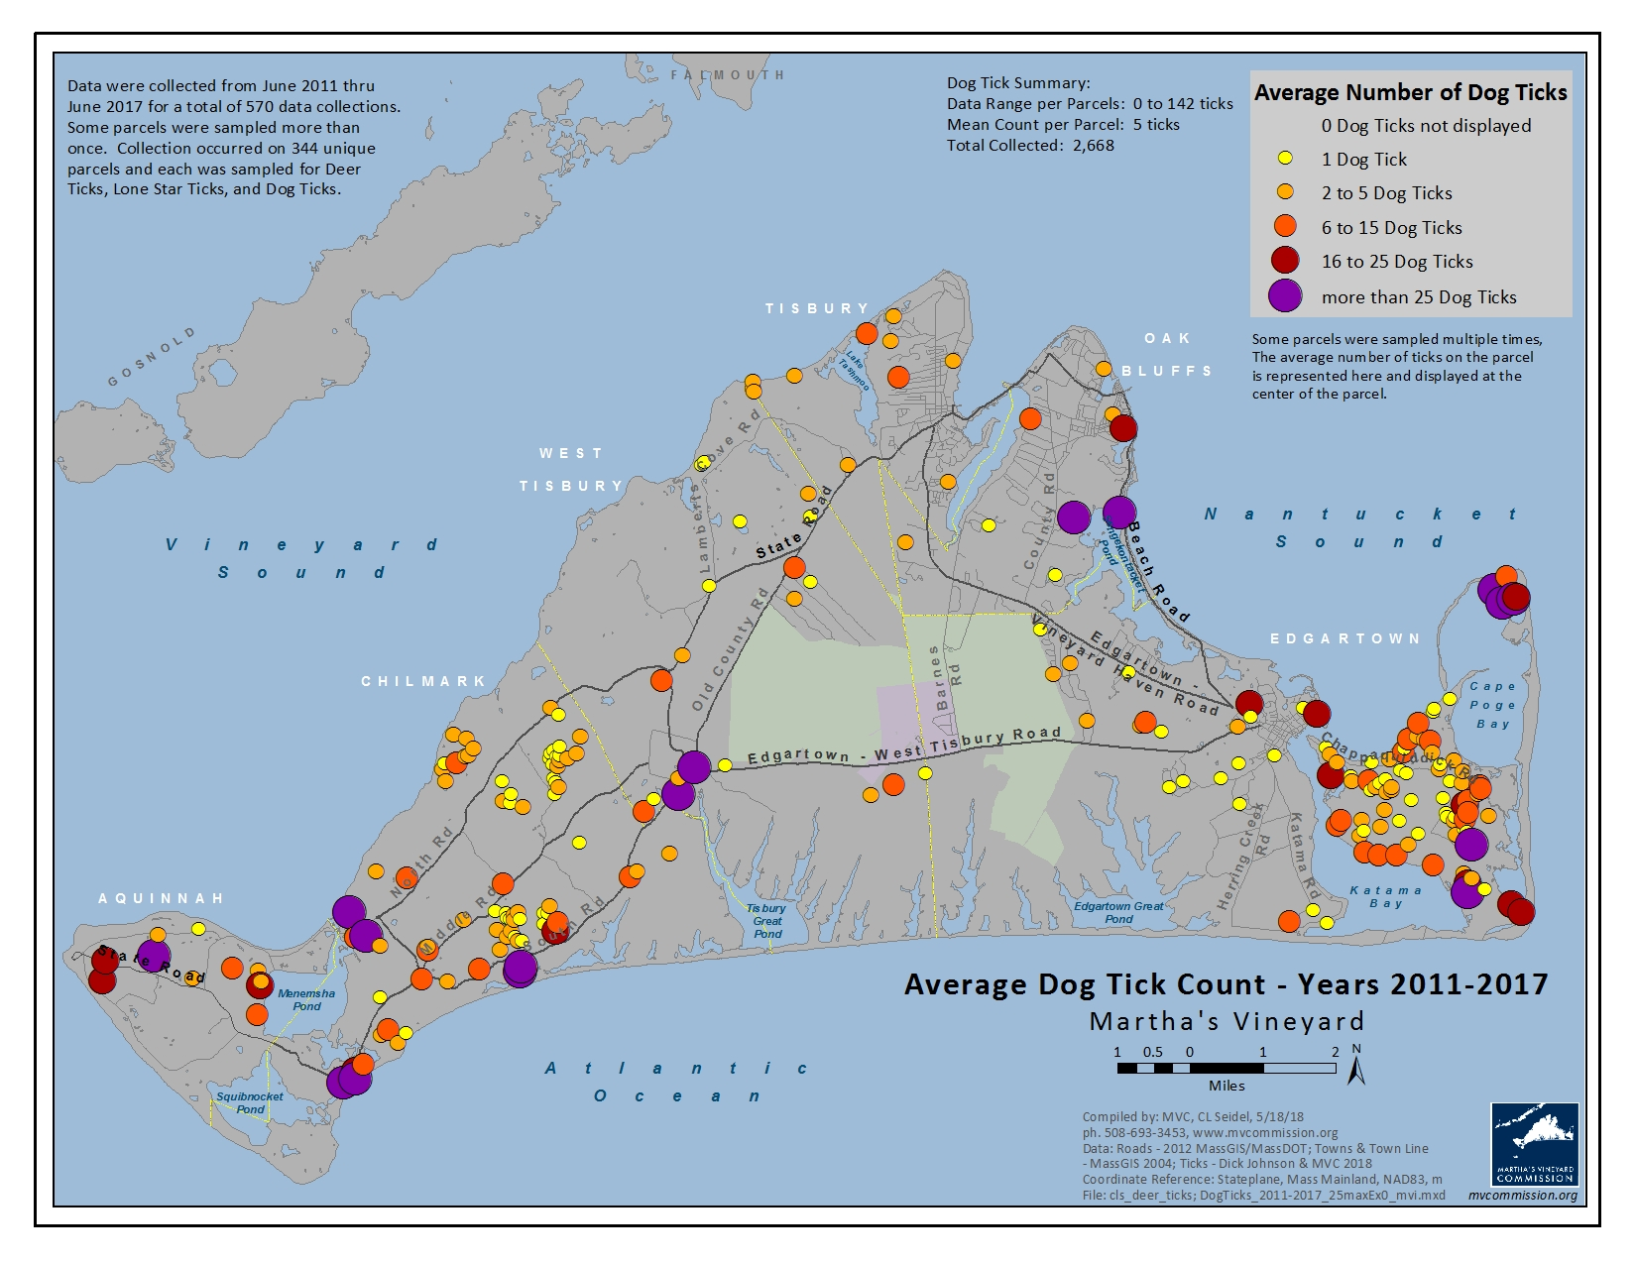

Slide 9
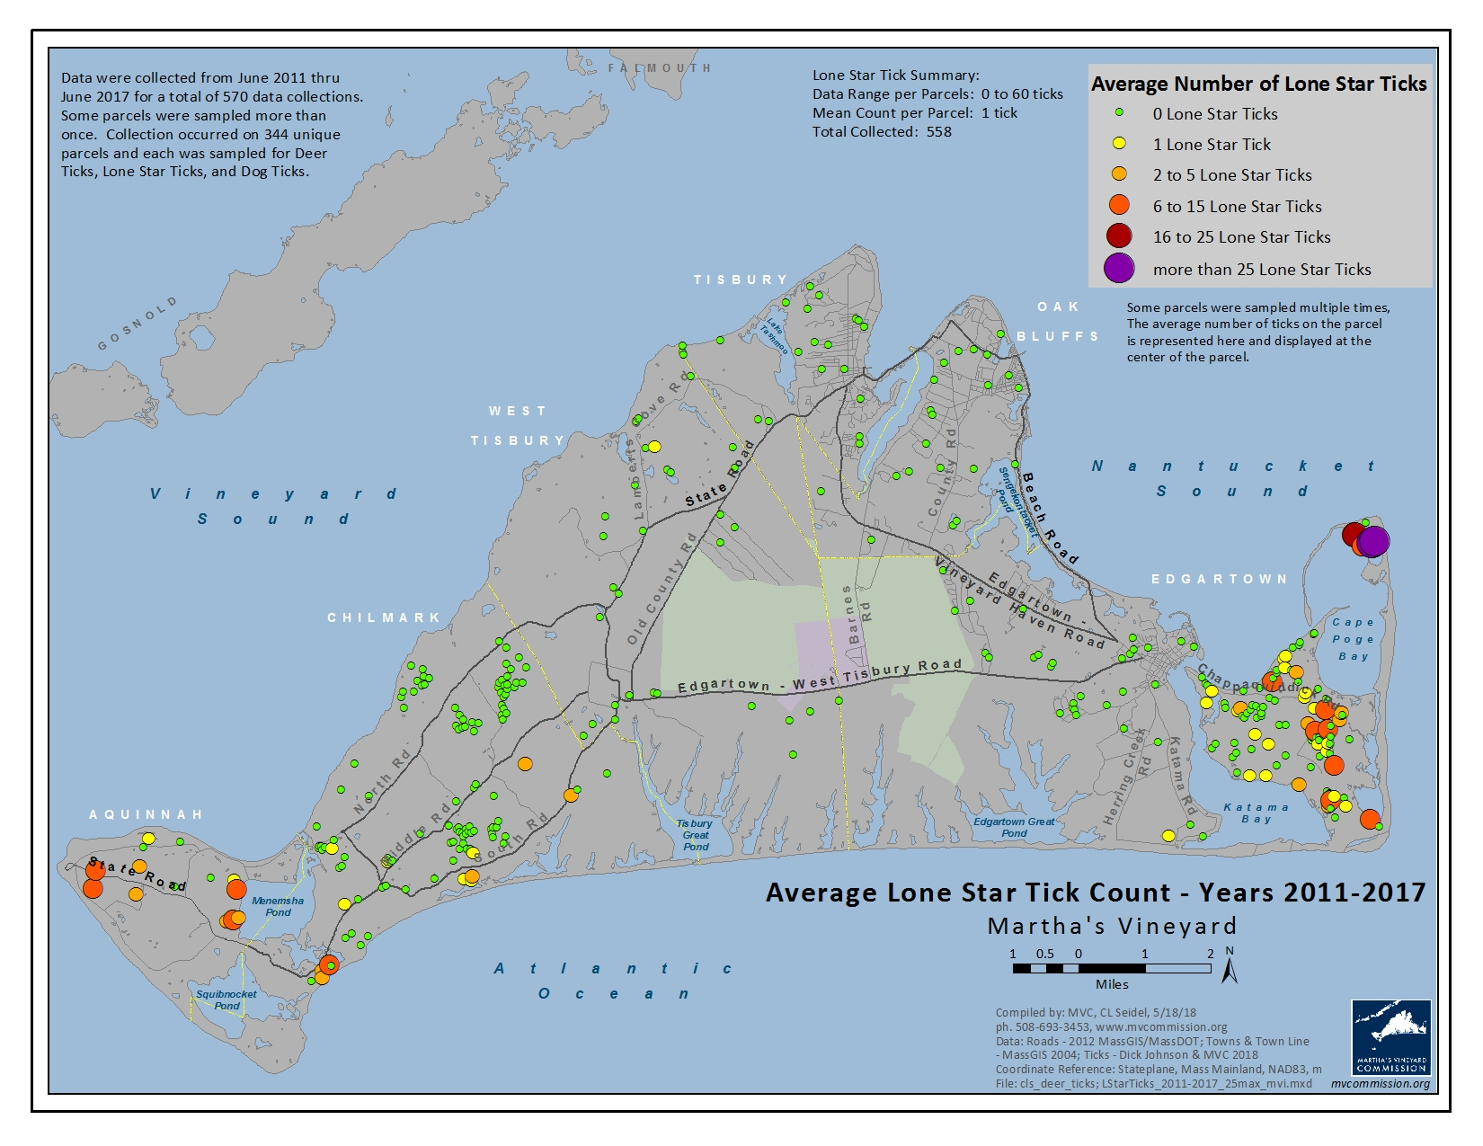

Slide 10
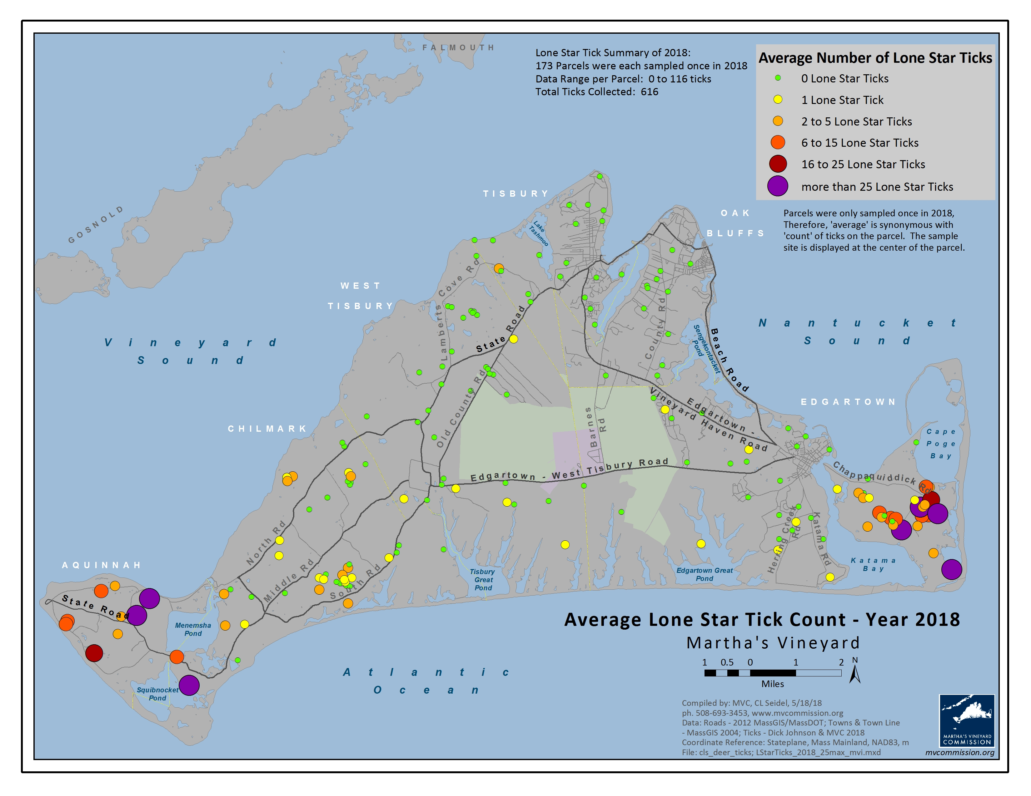
Map of Lone Star Ticks 2019

Slide 11
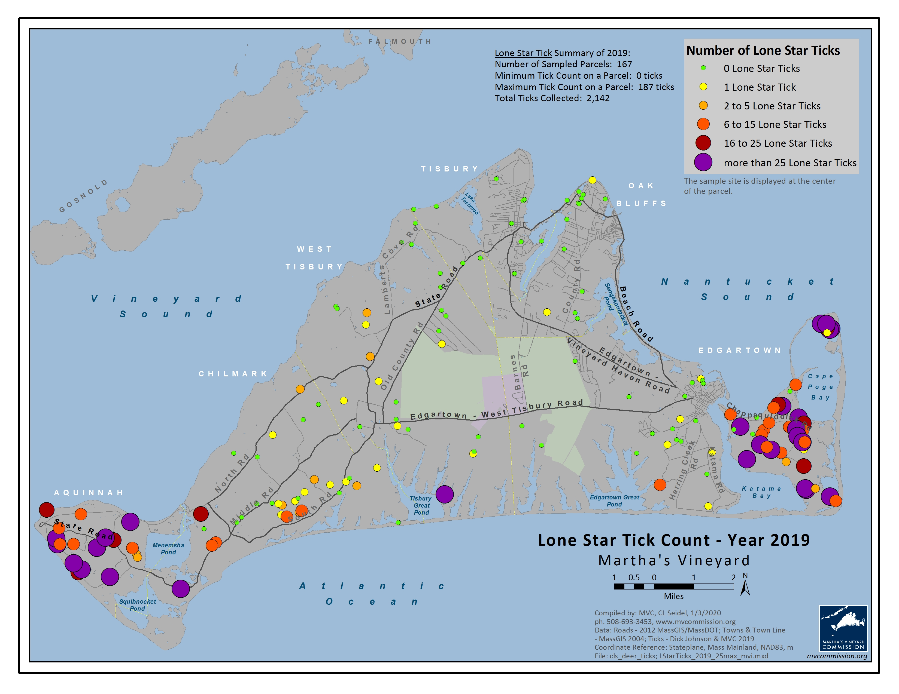

Slide 12
2019 Lone Star Ticks by Town
Number of Surveys # Surveys with % Surveys with
Town with Lone Star ticks with Lone Star Ticks
Aquinnah 20 20 100%
Chilmark 46 25 54%
West Tisbury 33 11 33%
Tisbury 11 0 0%
Oak Bluffs 14 2 14%
Edgartown 20 6 30%
(no Chappaquiddick)
Chappaquiddick 55 51 93%

Slide 13
Three Levels of Protection
Level 1
Reduce the likelihood of ticks biting you.
Level 2
Reduce the number of ticks in your yard.
Level 3
Reduce the number of ticks on the island.

Slide 14
Level 1
Reduce the likelihood of ticks biting you:
wear protective clothing treated with permethrin (buy pre-treated or spray your own).
use a DEET-based repellant (25% DEET on bare skin).
conduct thorough tick checks.
use tick repellant on dogs, either treated collars, topical application, or oral.

Slide 15
Level 2
Reduce the number of ticks in your yard:
For all ticks:
spray: permethrin or herbal-based
For deer ticks:
install 3-foot wide barrier of mulch or gravel between woods and edge of yard
prune shrubs and trees to increase sunlight reaching yard
use tick tubes
For deer and lone-star ticks:
remove dead leaves and pine needles from around house and edge of yard
remove invasive plants (such as bittersweet, bush honeysuckle and autumn/Russian olive)
For dog and lone-star ticks:
mow tall grass and weeds

Slide 16
Level 3
Reduce the number of ticks on the island:
reduce the number of deer.
act quickly and decisively or the lone star problem could get much worse very soon -- maybe in the next few years.

Slide 18
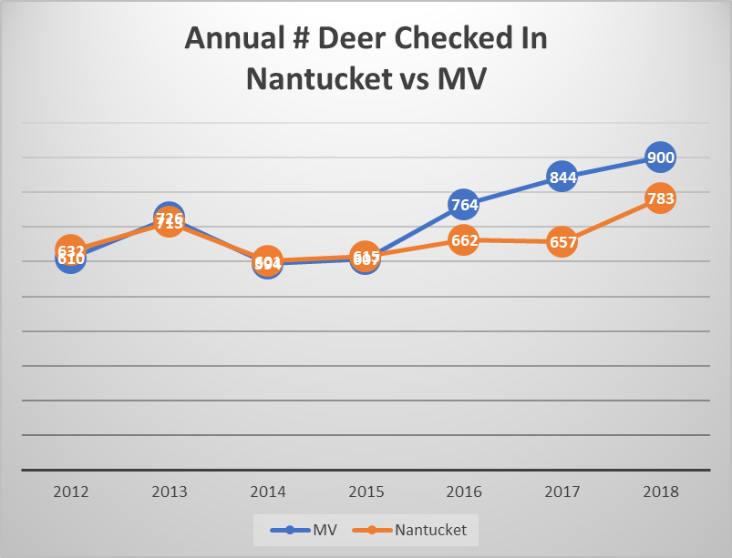

Slide 19
What to do?
1. Reduce number of deer by allowing bow hunting on more private land
2. Use carbon dioxide to attract lone star ticks
3. Bring back “4 posters”? Pros and cons
Will require even greater levels of community support:
increased financial support,
allowing hunting on individual properties, and
agreeing to hunting on nearby private property

Slide 20
For more information:
Email Richard Johnson mvticks@gmail.com
Visit Island boards of health website www.mvboh.com

